Slide 1
Introduction to data warehousing
MTN.BI.07
Dimensions and Facts Basics
Elias Nema
Lead Software Engineer
Elias_Nema@epam.com

Slide 2
Agenda
Dimension Entities Classification
Dimension Entities Hierarchies
Fact Entity Types

Slide 3
Grouping Dimension into Tables
Unlike an entity-relationship (ER) model, a dimensional model does not expose every relationship between attributes as a join.
There are 2 ways of Relating Dimension Attributes:
Explicit (Through Fact table).
Implicit (Inside Dimension).

Slide 4
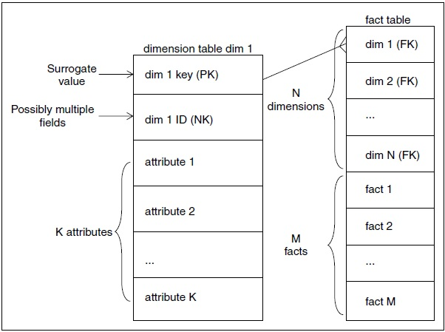
The Basic Structure of a Dimension
The primary key - The primary key of a dimension is used to join to fact tables.
The natural key - All dimension tables should possess one or more other fields that compose the natural key of the dimension.

Slide 5
Dimension Surrogates
According to Dictionary: Surrogate is an “artificial or synthetic product that is used as a substitute for a natural product.”
This primary key cannot be the operational system’s natural key because there will be multiple dimension rows for that natural key when changes are tracked over time.
Natural keys for a dimension may be created by more than one source system, and these natural keys may be incompatible or poorly administered.
Dimension surrogate keys are simple integers, assigned in sequence, starting with the value 1, every time a new key is needed.
Date Dim is the only exception for this rule.

Slide 6
Dimension Classification – Business & Size
Business Classification | Size Classification
Time, Calendar DIM Generic DIM Business DIM Junk DIM | Big Dimensions (often has millions of records and a hundred or more fields in each record). Small Dimensions (tiny lookup tables with only a few records and one or two columns).

Slide 7
Date Dimension
Date Dimension
Date Key (PK)
Full Date Description
Day of Week
Day Number in Calendar Month
Day Number in Calendar Year
Day Number in Fiscal Month
Day Number in Fiscal Year
Last Day in Month Indicator
Calendar Week Ending Date
Calendar Week Number in Year
Calendar Quarter
…
Fiscal …

Slide 8
Degenerate Dimension
Sales Fact
Order Date (FK)
Ship Date (FK)
Payment Date (FK)
Return Date (FK)
Sales Rep (FK)
Product (FK)
Customer (FK)
Order Number (DD) - Degenerate Dimension, can be useful for grouping together related fact tables rows
Quantity (Fact)
Dollar Amount (Fact)

Slide 9
History in Dimensions
Dimension Types:
Type 0: Retain Original
Type 1: Overwrite
Type 2: Add New Row
Type 3: Add New Attribute
Hybrid Slowly Changing Dimensions
and more…

Slide 10
Type 1: Overwrite
Primary Key | Natural Key | Prod Name | Category | Package Type
12358 | AB89 | 15zCola | Soft Drinks | Glass
↓
12358 | AB89 | 15zCola | Soft Drinks | Plastic

Slide 11
Type 2: Add New Row
Primary Key | Natural Key | Prod Name | Category | Package Type | Start Date | End Date | Is Current
12358 | AB89 | 15zCola | Soft Drinks | Glass | 10 Feb 2012 | 31 Dec 9999 | Current
↓
12358 | AB89 | 15zCola | Soft Drinks | Glass | 10 Feb 2012 | 12 Apr 2016 | Expired
25694 | AB89 | 15zCola | Soft Drinks | Plastic | 12 Apr 2016 | 31 Dec 9999 | Current

Slide 12
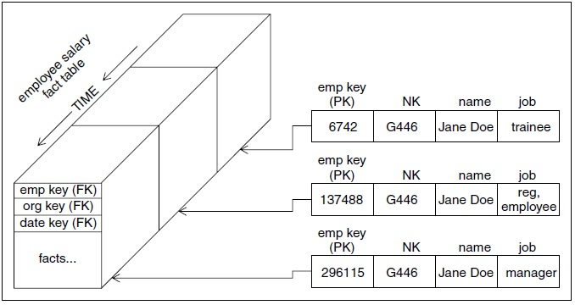
History with Type 2

Slide 13
Type 3: Add New Attribute
Primary Key | Natural Key | Prod Name | Category | Package Type | Old Package Type
12358 | AB89 | 15zCola | Soft Drinks | Glass | Not available
↓
12358 | AB89 | 15zCola | Soft Drinks | Plastic | Glass
↓
12358 | AB89 | 15zCola | Soft Drinks | Can | Plastic

Slide 14
Dimension hierarchies

Slide 15
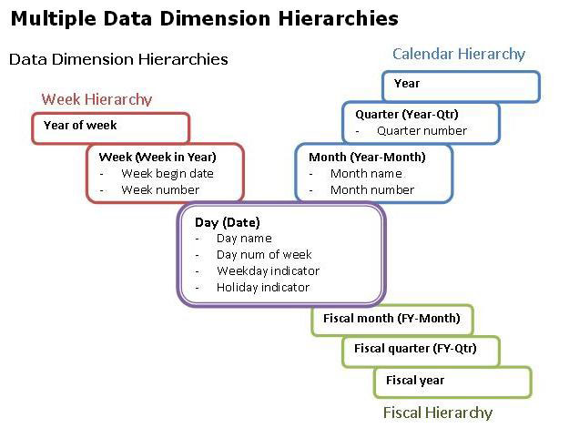
Hierarchies

Slide 16
Fact Entity Types

Slide 17
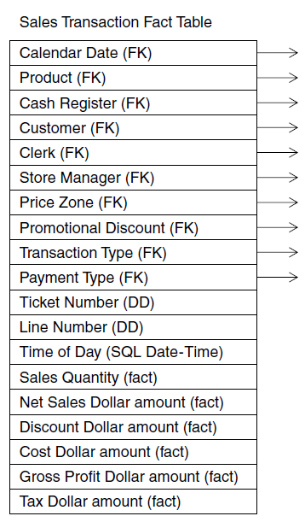
Fact Table Structure
Time & Date
Dimensions
Measurements
Degenerated Dims

Slide 18
NULLs in Fact Tables
Null-valued measurements behave gracefully in fact tables. The aggregate functions (SUM, COUNT, MIN, MAX, and AVG) all do the “right thing” with null facts.
However, nulls must be avoided in the fact table’s foreign keys. Rather than a null foreign key, the associated dimension table must have a default row (and surrogate key) representing the unknown or not applicable condition.

Slide 19
Fundamental Grains
Transaction | Periodic Snapshot | Accumulating Snapshot
Transaction Day (FK) | Reporting Month Key (FK) | Snapshot Date Key (FK)
Policy (FK) | Policy (FK) | Effective Date (FK)
Customer (FK) | Customer (FK) | Expiration Date (FK)
Agent (FK) | Agent (FK) | First Claim Date (FK)
Coverage (FK) | Coverage (FK) | Last Payment Date (FK)
Amount | Earned Premium | Policy (FK)
 | Change in Reverse | Customer (FK)
 | Reverse Balance | Agent (FK)
 | Number Transactions | Coverage (FK)
 |  | Number Claims to Date
 |  | Claim Payment to Date

Slide 20
Transaction
The transaction grained fact table represents an atomic action that occurs at an instantaneous point in time.
A record exists only if a transaction occurs.
The date key is accurate to the calendar day, and may be augmented with a date/time stamp accurate to the hour and minute.

Slide 21
Periodic Snapshot
Represents a predefined time span.
Usually, exactly one record exists for each combination of significant keys.
The time stamp on the periodic snapshot is only the name of the period and usually denotes the end of the period.

Slide 22
Accumulating Snapshot
Always have multiple time stamps.
One time stamp represents the last time the snapshot was updated, and the others represent generic or predictable events that may have taken place in the life of the coverage.
In dramatic contrast to the other fact table types, we frequently revisit accumulating snapshot fact records to update the facts.

Slide 23

Transactions and Snapshots
Transactions and snapshots are the yin and yang of an enterprise data warehouse.
Transactions give us the fullest possible view of detailed behavior, and snapshots allow you to measure the status of the enterprise quickly.

Slide 24
Dimensions and Facts Basics
Elias Nema
Lead Software Engineer
Elias_Nema@epam.com

